Slide 1
CyberSecurity

Slide 2
Part One

Slide 3

What is cybersecurity
A wide-ranging term that embraces all aspects of ensuring the protection of citizens, businesses and critical infrastructures from threats that arise from their use of computers and the internet.

Slide 4
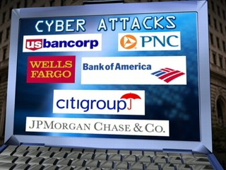
Scope of cybersecurity
Techniques of threat and attack analysis and mitigation
Protection and recovery technologies, processes and procedures for individuals, business and government
Policies, laws and regulation relevant to the use of computers and the Internet

Slide 5
A systems problem
Related to, but broader in scope than:
Computer security
Security engineering
Encryption
Computer crime
Computer forensics
Cybersecurity is a socio-technical systems problem
Problems almost always stem from a mix of technical, human and organisational causes

Slide 6
Malicious and accidental damage
Cybersecurity is most concerned with
Cyber attacks
Malicious attempts to cause loss or damage to an individual, business or public bodies
But it should also be concerned with
Cyber-accidents
Accidental events that can cause loss or damage to to an individual, business or public body
Many of the same technologies are applicable although sometimes protecting against cyber attacks increases the probability of cyber accidents

Slide 7
Insider and external attacks
Insider attacks
Attacks to an organisation carried out by someone who is inside that organisation
Difficult to counter using technical methods as the insider may have valid credentials to access the system
External attacks
Attacks to an organisation carried out by an external agent
Requires either valid credentials or the exploitation of some vulnerability to gain access to the systems

Slide 8
Classes of cyber attack
Cyber fraud
Cyber attacks that are generally aimed at gaining monetary or related gains for the perpetrator.
Cyber-spying
Cyber attacks aimed at gaining information for the perpetrator. Related to cyber-fraud in that one aim of cyber-spying may be to sell the information gained,
Cyber-stalking, cyber-bullying etc.
Cyber attacks which are designed to intimidate individuals rather than businesses or government

Slide 9
Classes of cyber attack
Cyber assault
Cyber-attacks aimed at causing damage to information or equipment that is being attacked. Again, related to cyber fraud in that some attacks such as DDOS attacks may be precursors to attempts to extort money from those affected by the attacks.
Damage may be physical damage to equipment, reputational damage, psychological damage to individuals (cyber bullying or cyber stalking) or damage to information.
Cyber warfare
An extreme form of cyber-assault where at least one of the parties involved is a nation state.

Slide 10
Cyber-fraud
Phishing attacks combined with fake websites to steal users’ personal details and, with these, steal money from their accounts
Fraudsters set up a fake website that looks like a bank website
Emails are sent to large numbers of recipients with a link to this site and a message trying to lure them to log on
If the click on the link, their personal details are collected and then used by the fraudster to access their legitimate site

Slide 11
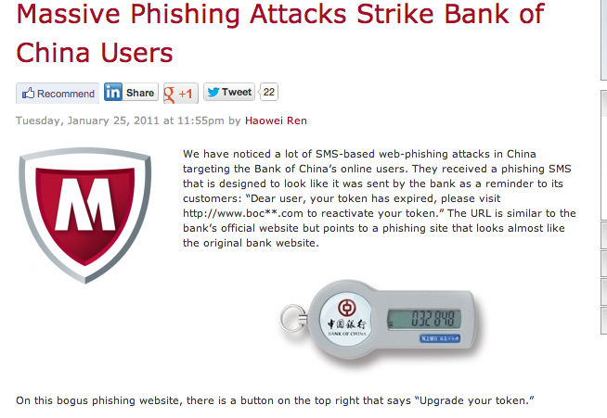

Slide 12
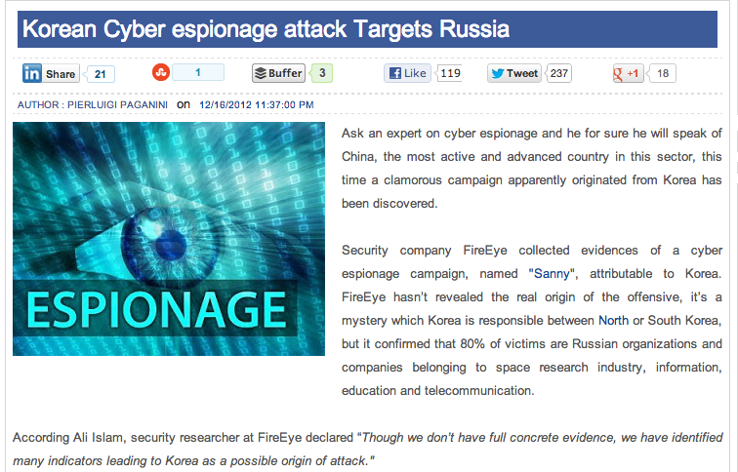
Cyber-spying

Slide 13
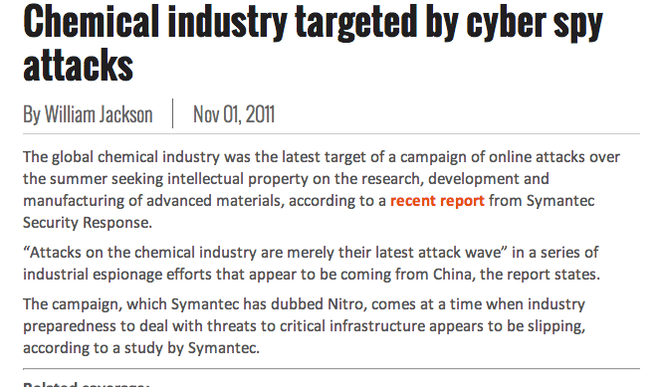
Cyber-spying

Slide 14
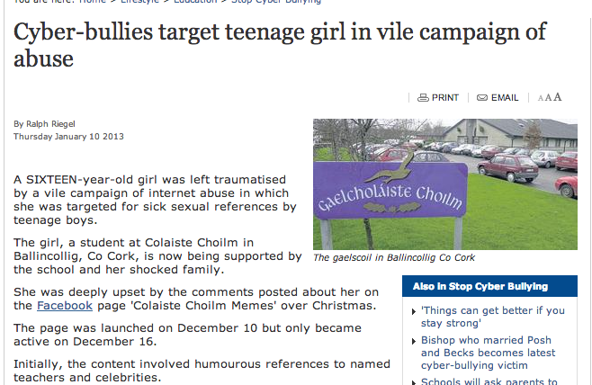
Cyber-bullying

Slide 15
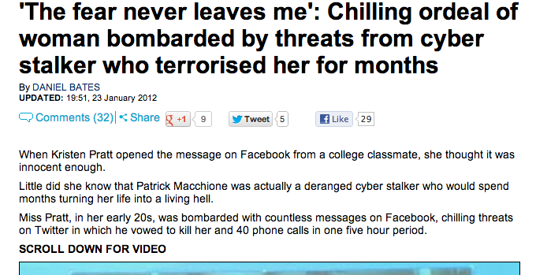
Cyber Stalking

Slide 16
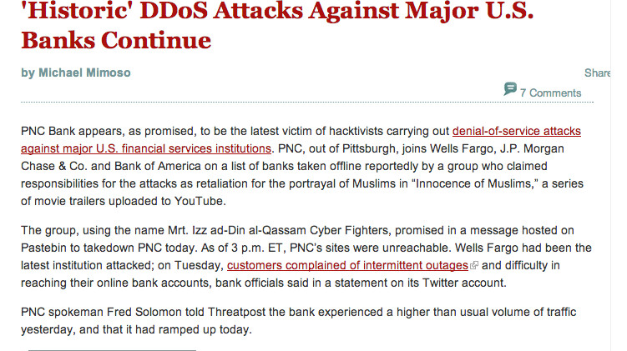
Cyber-assault

Slide 17
Cyber warfare attacks
These are much harder to validate as, for obvious reasons, neither the perpetrator or the victim wish to release information
Denial of service attacks
Government and critical infrastructure sites attacked by DoS attacks with a view to taking them offline
Malware
Malware introduced to target and damage government and infrastructure facilities

Slide 18
The scale of the problem
It’s a big problem
How big ? We really do not know
Many surveys on costs but very wide variations and different methodologies
Differing estimates:
Cybercrime in Scotland from £31 billion to £168 million
Industry reluctant to release figures but when they do, they tend to overvalue assets

Slide 19
Why has this problem arisen
Connection of computers to the internet can cut costs, improve the efficiency and responsiveness of business processes and open up new opportunities for interaction. Therefore business has focused on connectivity rather than security
Security is inconvenient and slows down transactions. Businesses have decided to prioritise convenience and usability over security.
There are inherent security weaknesses in the design of the Internet

Slide 20
Internet vulnerabilities
The Internet was invented in the 1970s as a network between organisations that were trustworthy and which trusted each other
Information maintained was largely non-commercial
Security was not a factor in the design of internet protocols, practices and equipment
These protocols made it easy for the Internet to be universally adopted in the 1990s but mean that we have to live with weak security.

Slide 21
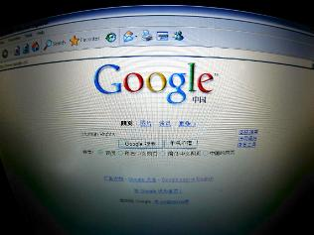
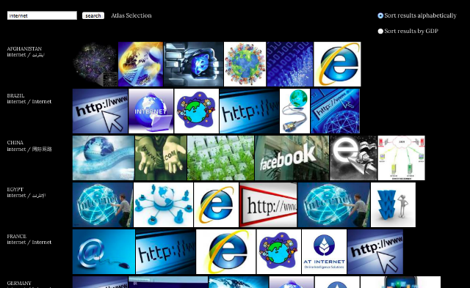
Internet vulnerability examples
Unencypted traffic
Packets can be intercepted and examined by an attacker
DNS system
Possible to divert traffic from legitimate to malicious addresses
Easy to hide where traffic has come from
Mail protocol
No charging mechanism for mail
Hence spam is possible

Slide 22
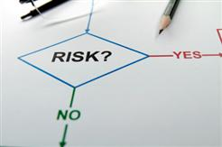

Risk classification
Risks due to actions of people
Risks due to hardware or software
Risks due to organisational processes
There are also
Risks due to external events such as weather, infrastructure failure, regulatory changes.
But these are more difficult to anticipate and control

Slide 23
Actions of people
Deliberate or accidental exposure of legitimate credentials to attackers
Failure to maintain secure personal computers and devices
Insider corruption or theft of data
Preference for convenience and usability over security
Weak passwords set because they are easy to remember and quick to type

Slide 24
Hardware and software
Misconfigured firewalls and mail filters
Programming errors and omissions in software lead to malicious penetration
Buffer overflow attacks
SQL poisoning attacks
Inadequate server or router capacity leads to failure in the event of DoS attack

Slide 25
Organisational processes
No established process and checks for updating and patching software
Lack of security auditing
Lack of systematic backup processes

Slide 26
Key points
Cybersecurity is concerned with all aspects of ensuring the protection of citizens, businesses and critical infrastructures from threats that arise from their use of computers and the internet.
Cybersecurity is a socio-technical systems problem
Cybersecurity covers cyber-fraud, cyber-spying, cyber-bullying, cyber-assault and cyber-warfare
Cyber attacks are a major cost for business, government and individuals. But quantifying this cost is difficult.

Slide 27
Part Two

Slide 28
Attacks Framework
Attacks
Physical Access
Attacks
--
Wiretapping
Server Hacking
Vandalism
Social Engineering
--
Opening Attachments
Password Theft
Information Theft
Dialog Attacks
--
Eavesdropping
Impersonation
Message Alteration
Penetration
Attacks
Malware
--
Viruses
Worms
Scanning
(Probing)
Denial of
Service
Break-in

Slide 29
Social Engineering Attacks
Social Engineering
Tricking an employee into giving out information or taking an action that reduces security or harms a system
Opening an e-mail attachment that may contain a virus
Asking for a password claiming to be someone with rights to know it
Asking for a file to be sent to you

Slide 30
Eavesdropping on a Dialog
Dialog
Hello
Client PC
Bob
Server
Alice
Hello
Attacker (Eve) intercepts
and reads messages

Slide 31
Impersonation and Authentication
I’m Bob
Prove it!
(Authenticate Yourself)
Client PC
Bob
Attacker
(Eve)
Server
Alice

Slide 32
Message Alteration
Dialog
Balance =
£1
Balance =
£1,000,000
Client PC
Bob
Server
Alice
Balance =
£1
Balance =
£1,000,000
Attacker (Eve) intercepts
and alters messages

Slide 33
Scanning (Probing) Attacks
Reply from 172.16.99.1
Probe Packets to
172.16.99.1, 172.16.99.2, etc.
Host
172.16.99.1
Internet
Attacker
No Host
172.16.99.2
No Reply
Results
172.16.99.1 is reachable
172.16.99.2 is not reachable
…
Corporate Network

Slide 34
Denial-of-Service (DoS) Flooding Attack
Message Flood
Server
Overloaded By
Message Flood
Attacker

Slide 35
Network Penetration Attacks
Passed Packet
Attack
Packet
Internet
Firewall
Hardened
Client PC
Internet
Attacker
Dropped
Packet
Hardened
Server
Internal
Corporate
Network
Log File

Slide 36
Part Three

Slide 37
Challenges
No single simple solution to protecting the It Infrastructure
Different types of attacks
Difficulties in defending against these attacks

Slide 38
Today’s Security Attacks
Refer to your own list!

Slide 39
Difficulties in Defending Against Attacks
Speed of attacks
Greater sophistication of attacks
Simplicity of attack tools
Quicker detection of vulnerabilities
Zero day attack
Delays in patching products
Distributed attacks
User confusion

Slide 40
Who Are the Attackers?
Divided into several categories
Hackers
Spies
Employees
Cyber criminals
Cyber terrorists

Slide 41
Hackers
Debated definition of hacker
Identify anyone who illegally breaks into or attempts to break into a computer system
Usually, with advanced computing skills

Slide 42
Spies
Person who has been hired to break into a computer and steal information
Do not randomly search for unsecured computers
Hired to attack a specific computer or system
Goal
Break into computer or system
Take the information without drawing any attention to their actions

Slide 43
Employees
Reasons for attacks by employees
Show company weakness in security
Retaliation
Money
Blackmail
Carelessness

Slide 44
Cybercriminals
Network of attackers, identity thieves, and financial fraudsters
Motivated by money
Financial cybercrime categories
Stolen financial data
Spam email to sell counterfeits, etc.

Slide 45
Cyberterrorists
Motivated by ideology

Slide 46
Attacks and Defences
Same basic steps are used in most attacks
Protecting computers against these steps
Calls for five fundamental security principles

Slide 47
Steps of an Attack
Probe for information
Penetrate any defences
Modify security settings
Circulate to other systems
Paralyse networks and devices

Slide 48
Defences Against Attacks
Layering
If one layer is penetrated, several more layers must still be breached
Each layer is often more difficult or complicated than the previous
Useful in resisting a variety of attacks
Limiting
Limiting access to information reduces the threat against it
Technology-based and procedural methods

Slide 49
Defences Against Attacks (cont’d.)
Diversity
Important that security layers are diverse
Breaching one security layer does not compromise the whole system
Obscurity
Avoiding clear patterns of behavior make attacks from the outside much more difficult
Simplicity
Complex security systems can be hard to understand, troubleshoot, and feel secure about

